Slide 1
Chapter 3 - Structured Program Development
Outline
3.1 Introduction
3.2 Algorithms
3.3 Pseudocode
3.4 Control Structures
3.5 The If Selection Statement
3.6 The If…Else Selection Statement
3.7 The While Repetition Statement
3.8 Formulating Algorithms: Case Study 1 (Counter-Controlled Repetition)
3.9 Formulating Algorithms with Top-down, Stepwise Refinement: Case Study 2 (Sentinel-Controlled Repetition)
3.10 Formulating Algorithms with Top-down, Stepwise Refinement: Case Study 3 (Nested Control Structures)
3.11 Assignment Operators
3.12 Increment and Decrement Operators

Slide 2
Objectives
In this chapter, you will learn:
  To understand basic problem solving techniques.
  To be able to develop algorithms through the process of top-down, stepwise refinement.
  To be able to use the if selection statement and if…else selection statement to select actions.
  To be able to use the while repetition statement to execute statements in a program repeatedly.
  To understand counter-controlled repetition and sentinel-controlled repetition.
  To understand structured programming.
  To be able to use the increment, decrement and assignment operators.

Slide 3
3.1 Introduction
Before writing a program:
  Have a thorough understanding of the problem
  Carefully plan an approach for solving it
While writing a program:
  Know what “building blocks” are available
  Use good programming principles

Slide 4
3.2 Algorithms
Computing problems
  All can be solved by executing a series of actions in a specific order
Algorithm: procedure in terms of
  Actions to be executed
  The order in which these actions are to be executed
Program control
  Specify order in which statements are to be executed

Slide 5
3.3 Pseudocode
Pseudocode
  Artificial, informal language that helps us develop algorithms
  Similar to everyday English
  Not actually executed on computers
  Helps us “think out” a program before writing it
    Easy to convert into a corresponding C++ program
    Consists only of executable statements

Slide 6
3.4 Control Structures
Sequential execution
  Statements executed one after the other in the order written
Transfer of control
  When the next statement executed is not the next one in sequence
  Overuse of goto statements led to many problems
Bohm and Jacopini
  All programs written in terms of 3 control structures
    Sequence structures: Built into C. Programs executed sequentially by default
    Selection structures: C has three types: if, if…else, and switch
    Repetition structures: C has three types: while, do…while and for

Slide 7
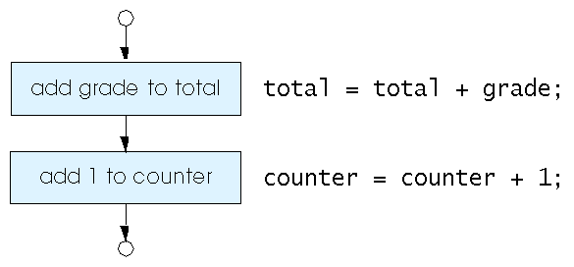
3.4 Control Structures
Figure 3.1 Flowcharting C’s sequence structure.

Slide 8
3.4 Control Structures
Flowchart
  Graphical representation of an algorithm
  Drawn using certain special-purpose symbols connected by arrows called flowlines
  Rectangle symbol (action symbol):
    Indicates any type of action
  Oval symbol:
    Indicates the beginning or end of a program or a section of code
Single-entry/single-exit control structures
  Connect exit point of one control structure to entry point of the next (control-structure stacking)
  Makes programs easy to build

Slide 9
3.5 The if Selection Statement
Selection structure:
  Used to choose among alternative courses of action
  Pseudocode:
    If student’s grade is greater than or equal to 60
    Print “Passed”
If condition true
  Print statement executed and program goes on to next statement
  If false, print statement is ignored and the program goes onto the next statement
  Indenting makes programs easier to read
    C ignores whitespace characters

Slide 10
3.5 The if Selection Statement
Pseudocode statement in C:
    if ( grade >= 60 )
    printf( "Passed\n" );
  C code corresponds closely to the pseudocode
Diamond symbol (decision symbol)
  Indicates decision is to be made
  Contains an expression that can be true or false
  Test the condition, follow appropriate path

Slide 11
3.5 The if Selection Statement
if statement is a single-entry/single-exit structure
A decision can be made on any expression.
zero - false
nonzero - true
Example:
3 - 4 is true
true
grade >= 60
print “Passed”
false

Slide 12
3.6 The if…else Selection Statement
if
  Only performs an action if the condition is true
if…else
  Specifies an action to be performed both when the condition is true and when it is false
Psuedocode:
    If student’s grade is greater than or equal to 60
    Print “Passed”
    else
    Print “Failed”
  Note spacing/indentation conventions

Slide 13
3.6 The if…else Selection Statement
C code:
    if ( grade >= 60 )
    printf( "Passed\n");
    else
    printf( "Failed\n");
Ternary conditional operator (?:)
  Takes three arguments (condition, value if true, value if false)
  Our pseudocode could be written:
    printf( "%s\n", grade >= 60 ? "Passed" : "Failed" );
  Or it could have been written:
    grade >= 60 ? printf( “Passed\n” ) : printf( “Failed\n” );

Slide 14
3.6 The if…else Selection Statement
Flow chart of the if…else selection statement
Nested if…else statements
  Test for multiple cases by placing if…else selection statements inside if…else selection statement
  Once condition is met, rest of statements skipped
  Deep indentation usually not used in practice
false
true
grade >= 60
print “Failed”
print “Passed”

Slide 15
3.6 The if…else Selection Statement
  Pseudocode for a nested if…else statement
  If student’s grade is greater than or equal to 90
  Print “A”
  else
  If student’s grade is greater than or equal to 80
  Print “B”
  else
  If student’s grade is greater than or equal to 70
  Print “C”
  else
  If student’s grade is greater than or equal to 60
  Print “D”
  else
  Print “F”

Slide 16
3.6 The if…else Selection Statement
Compound statement:
  Set of statements within a pair of braces
  Example:
    if ( grade >= 60 )
    printf( "Passed.\n" );
    else {
    printf( "Failed.\n" );
    printf( "You must take this course
    again.\n" );
    }
  Without the braces, the statement
      printf( "You must take this course
      again.\n" );
    would be executed automatically

Slide 17
3.6 The if…else Selection Statement
Block:
  Compound statements with declarations
Syntax errors
  Caught by compiler
Logic errors:
  Have their effect at execution time
  Non-fatal: program runs, but has incorrect output
  Fatal: program exits prematurely

Slide 18
3.7 The while Repetition Statement
Repetition structure
  Programmer specifies an action to be repeated while some condition remains true
  Psuedocode:
    While there are more items on my shopping list
    Purchase next item and cross it off my list
  while loop repeated until condition becomes false

Slide 19
3.7 The while Repetition Statement
Example:
    int product = 2;
    while ( product <= 1000 )
    product = 2 * product;
true
product <= 1000
product = 2 * product
false

Slide 20
3.8 Formulating Algorithms
(Counter-Controlled Repetition)
Counter-controlled repetition
  Loop repeated until counter reaches a certain value
  Definite repetition: number of repetitions is known
  Example: A class of ten students took a quiz. The grades (integers in the range 0 to 100) for this quiz are available to you. Determine the class average on the quiz
  Pseudocode:
    Set total to zero
    Set grade counter to one
    While grade counter is less than or equal to ten
    Input the next grade
    Add the grade into the total
    Add one to the grade counter
    Set the class average to the total divided by ten
    Print the class average

Slide 21
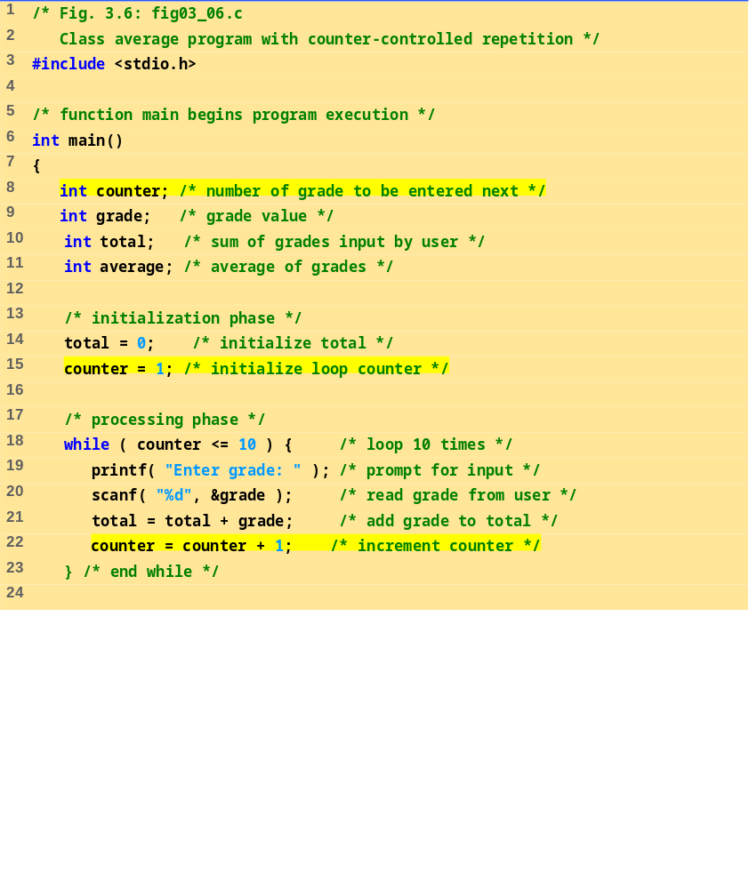
fig03_06.c (Part 1 of 2)

Slide 22
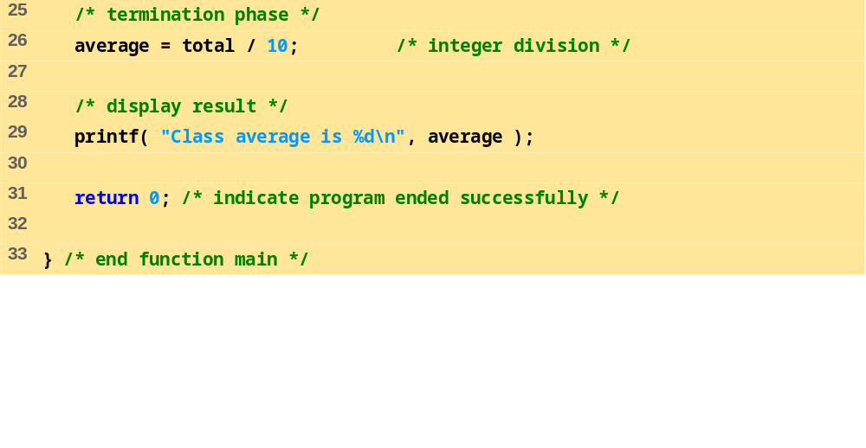
fig03_06.c (Part 2 of 2)
Program Output
Enter grade: 98
Enter grade: 76
Enter grade: 71
Enter grade: 87
Enter grade: 83
Enter grade: 90
Enter grade: 57
Enter grade: 79
Enter grade: 82
Enter grade: 94
Class average is 81

Slide 23
3.9 Formulating Algorithms with Top-Down, Stepwise Refinement
Problem becomes:
  Develop a class-averaging program that will process an arbitrary number of grades each time the program is run.
  Unknown number of students
  How will the program know to end?
Use sentinel value
  Also called signal value, dummy value, or flag value
  Indicates “end of data entry.”
  Loop ends when user inputs the sentinel value
  Sentinel value chosen so it cannot be confused with a regular input (such as -1 in this case)

Slide 24
3.9 Formulating Algorithms with Top-Down, Stepwise Refinement
Top-down, stepwise refinement
  Begin with a pseudocode representation of the top:
    Determine the class average for the quiz
  Divide top into smaller tasks and list them in order:
    Initialize variables
    Input, sum and count the quiz grades
    Calculate and print the class average
Many programs have three phases:
  Initialization: initializes the program variables
  Processing: inputs data values and adjusts program variables accordingly
  Termination: calculates and prints the final results

Slide 25
3.9 Formulating Algorithms with Top-Down, Stepwise Refinement
Refine the initialization phase from Initialize variables to:
    Initialize total to zero
    Initialize counter to zero
Refine Input, sum and count the quiz grades to
    Input the first grade (possibly the sentinel)
    While the user has not as yet entered the sentinel
    Add this grade into the running total
    Add one to the grade counter
    Input the next grade (possibly the sentinel)

Slide 26
3.9 Formulating Algorithms with Top-Down, Stepwise Refinement
Refine Calculate and print the class average to
    If the counter is not equal to zero
    Set the average to the total divided by the counter
    Print the average
    else
    Print “No grades were entered”

Slide 27
3.9 Formulating Algorithms with Top-Down, Stepwise Refinement
    Initialize total to zero
    Initialize counter to zero
    Input the first grade
    While the user has not as yet entered the sentinel
    Add this grade into the running total
    Add one to the grade counter
    Input the next grade (possibly the sentinel)
    If the counter is not equal to zero
    Set the average to the total divided by the counter
    Print the average
    else
    Print “No grades were entered”

Slide 28
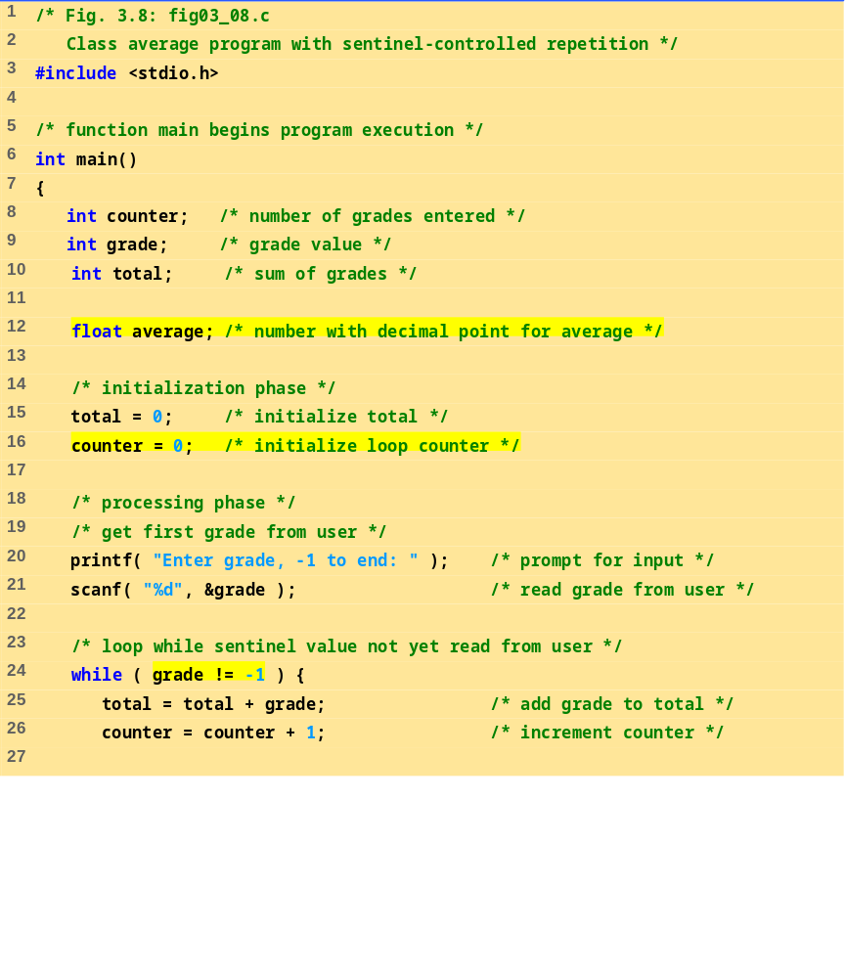
fig03_08.c (Part 1 of 2)

Slide 29
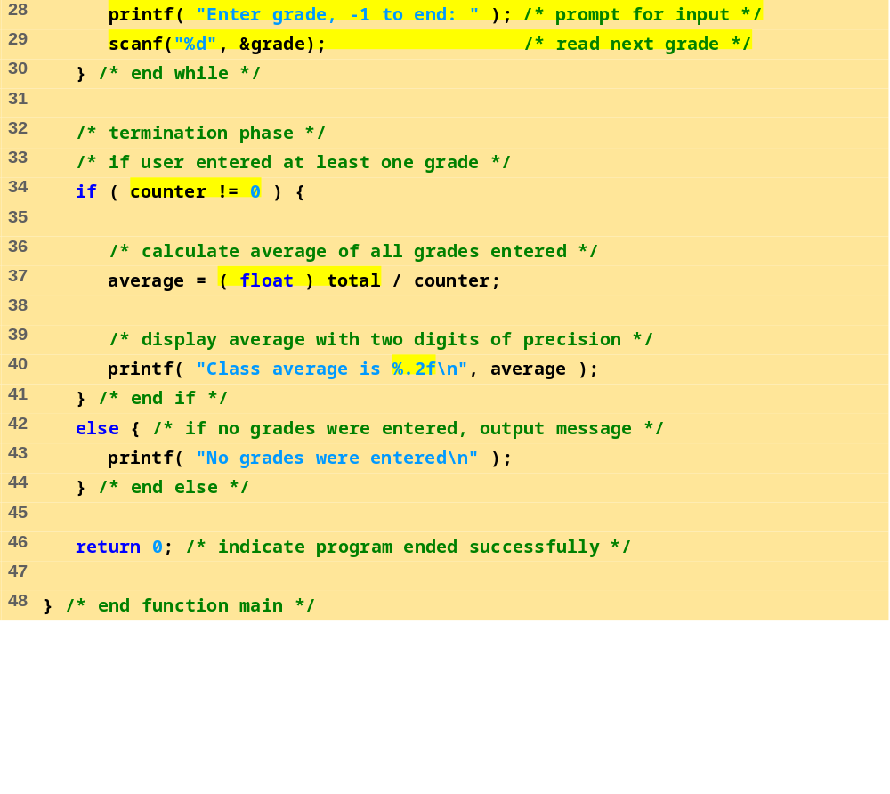
fig03_08.c (Part 2 of 2)

Slide 30
Enter grade, -1 to end: 75
Enter grade, -1 to end: 94
Enter grade, -1 to end: 97
Enter grade, -1 to end: 88
Enter grade, -1 to end: 70
Enter grade, -1 to end: 64
Enter grade, -1 to end: 83
Enter grade, -1 to end: 89
Enter grade, -1 to end: -1
Class average is 82.50
Program Output
Enter grade, -1 to end: -1
No grades were entered

Slide 31
3.10 Nested control structures
Problem
  A college has a list of test results (1 = pass, 2 = fail) for 10 students
  Write a program that analyzes the results
    If more than 8 students pass, print "Raise Tuition"
Notice that
  The program must process 10 test results
    Counter-controlled loop will be used
  Two counters can be used
    One for number of passes, one for number of fails
  Each test result is a number—either a 1 or a 2
    If the number is not a 1, we assume that it is a 2

Slide 32
3.10 Nested control structures
Top level outline
    Analyze exam results and decide if tuition should be raised
First Refinement
    Initialize variables
    Input the ten quiz grades and count passes and failures
    Print a summary of the exam results and decide if tuition should be raised
Refine Initialize variables to
    Initialize passes to zero
    Initialize failures to zero
    Initialize student counter to one

Slide 33
3.10 Nested control structures
Refine Input the ten quiz grades and count passes and failures to
    While student counter is less than or equal to ten
    Input the next exam result
    If the student passed
    Add one to passes
    else
    Add one to failures
    Add one to student counter
Refine Print a summary of the exam results and decide if tuition should be raised to
    Print the number of passes
    Print the number of failures
    If more than eight students passed
    Print “Raise tuition”

Slide 34
3.10 Nested control structures
Initialize passes to zero
Initialize failures to zero
Initialize student to one
    While student counter is less than or equal to ten
    Input the next exam result
    If the student passed
    Add one to passes
    else
    Add one to failures
    Add one to student counter
    Print the number of passes
    Print the number of failures
    If more than eight students passed
    Print “Raise tuition”

Slide 35
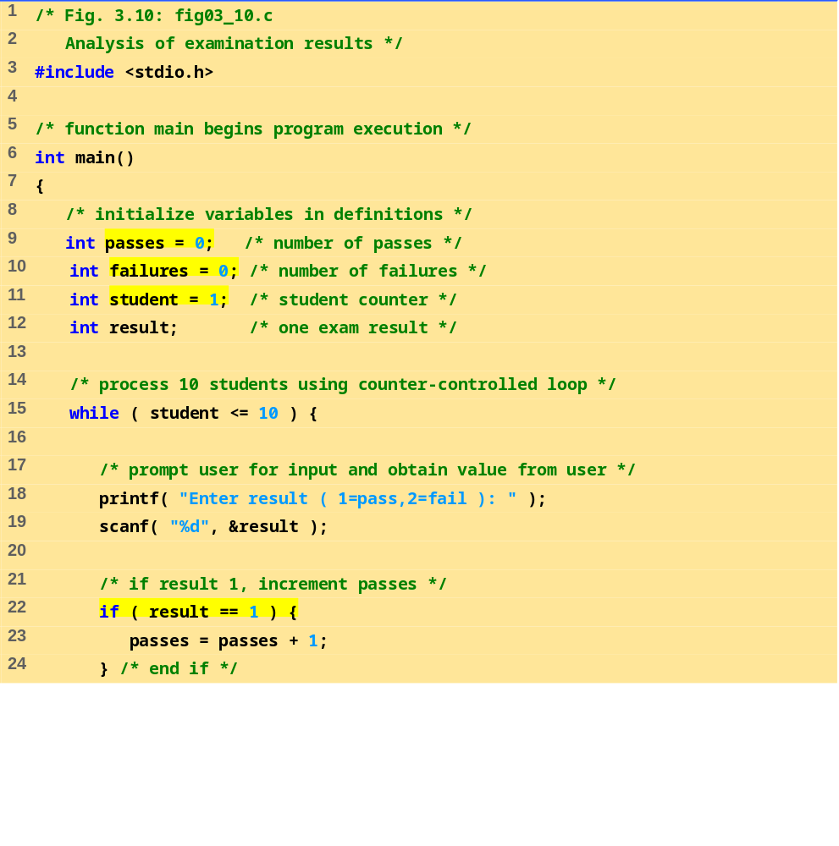
fig03_10.c (Part 1 of 2)

Slide 36
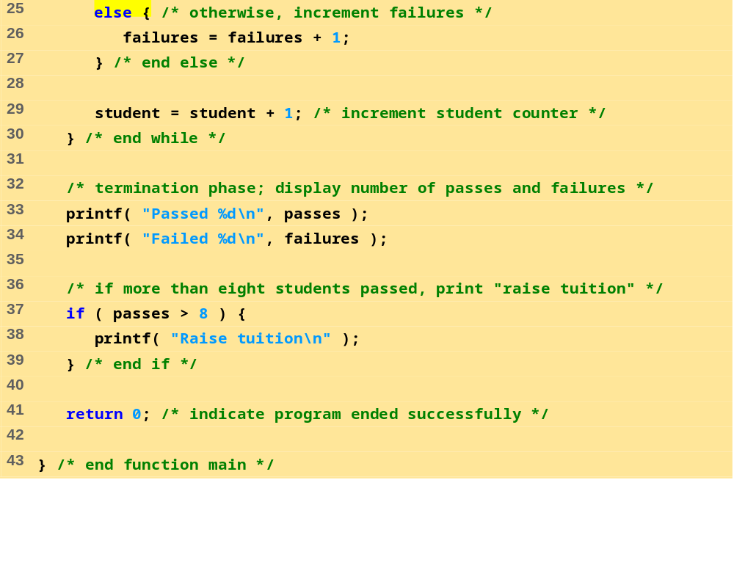
fig03_10.c (Part 2 of 2)

Slide 37
Enter Result (1=pass,2=fail): 1
Enter Result (1=pass,2=fail): 2
Enter Result (1=pass,2=fail): 2
Enter Result (1=pass,2=fail): 1
Enter Result (1=pass,2=fail): 1
Enter Result (1=pass,2=fail): 1
Enter Result (1=pass,2=fail): 2
Enter Result (1=pass,2=fail): 1
Enter Result (1=pass,2=fail): 1
Enter Result (1=pass,2=fail): 2
Passed 6
Failed 4
Program Output
Enter Result (1=pass,2=fail): 1
Enter Result (1=pass,2=fail): 1
Enter Result (1=pass,2=fail): 1
Enter Result (1=pass,2=fail): 2
Enter Result (1=pass,2=fail): 1
Enter Result (1=pass,2=fail): 1
Enter Result (1=pass,2=fail): 1
Enter Result (1=pass,2=fail): 1
Enter Result (1=pass,2=fail): 1
Enter Result (1=pass,2=fail): 1
Passed 9
Failed 1
Raise tuition

Slide 38
3.11 Assignment Operators
Assignment operators abbreviate assignment expressions
    c = c + 3;
  can be abbreviated as c += 3; using the addition assignment operator
Statements of the form
    variable = variable operator expression;
  can be rewritten as
    variable operator= expression;
Examples of other assignment operators:
    d -= 4 (d = d - 4)
    e *= 5 (e = e * 5)
    f /= 3 (f = f / 3)
    g %= 9 (g = g % 9)

Slide 39
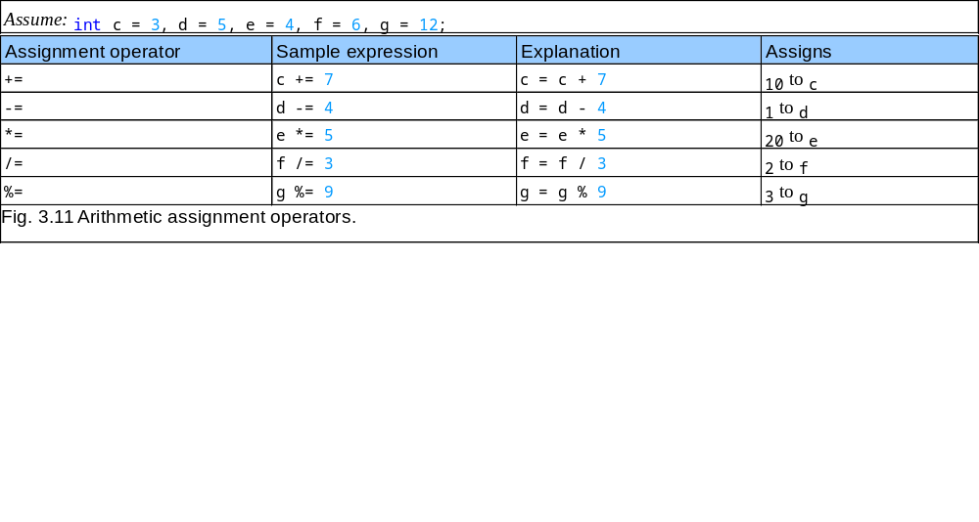
3.11 Assignment Operators

Slide 40
3.12 Increment and Decrement Operators
Increment operator (++)
  Can be used instead of c+=1
Decrement operator (--)
  Can be used instead of c-=1
Preincrement
  Operator is used before the variable (++c or --c)
  Variable is changed before the expression it is in is evaluated
Postincrement
  Operator is used after the variable (c++ or c--)
  Expression executes before the variable is changed

Slide 41
3.12 Increment and Decrement Operators
If c equals 5, then
    printf( "%d", ++c );
  Prints 6
    printf( "%d", c++ );
  Prints 5
  In either case, c now has the value of 6
When variable not in an expression
  Preincrementing and postincrementing have the same effect
    ++c;
    printf( “%d”, c );
  Has the same effect as
    c++;
    printf( “%d”, c );

Slide 42
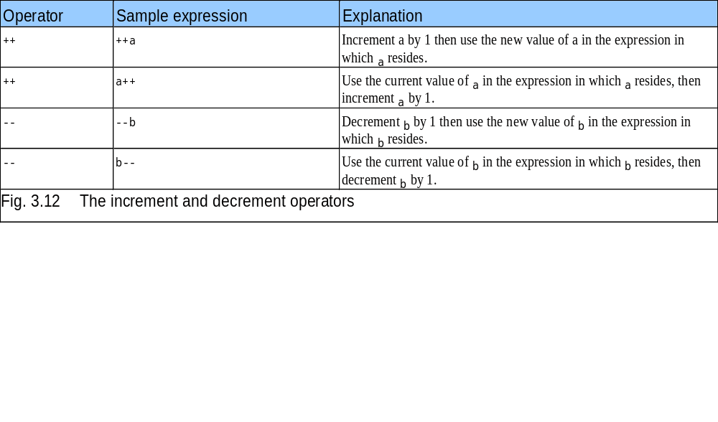
3.12 Increment and Decrement Operators

Slide 43
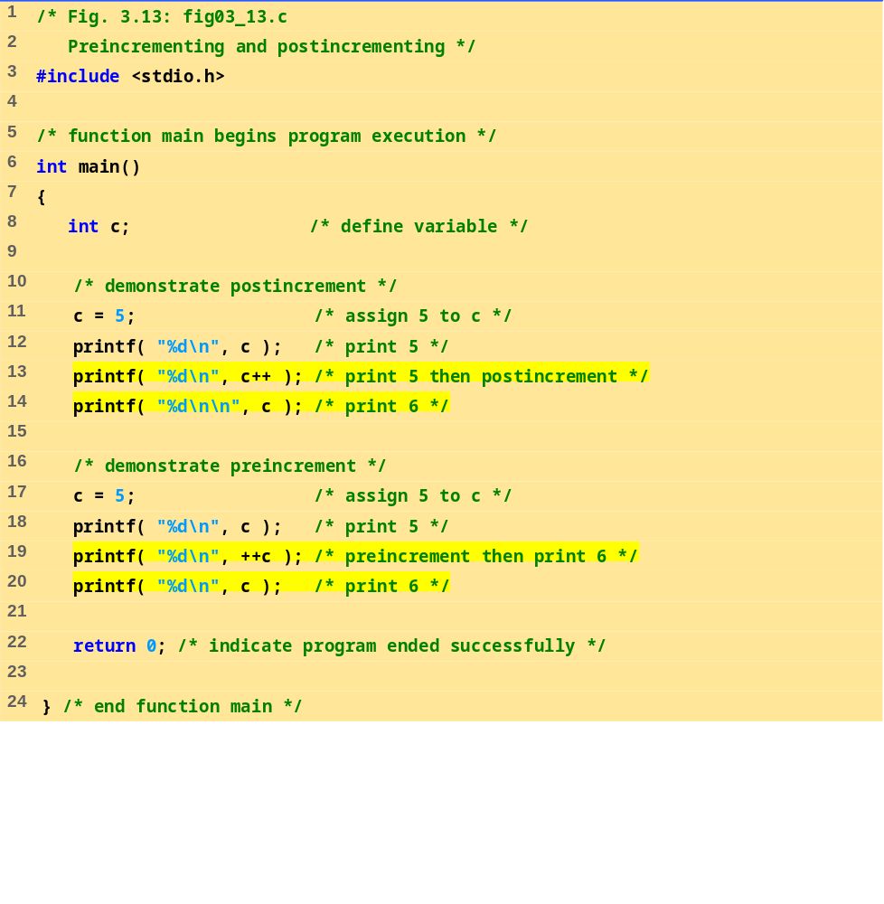
fig03_13.c

Slide 44
5
5
6
5
6
6
Program Output

Slide 45
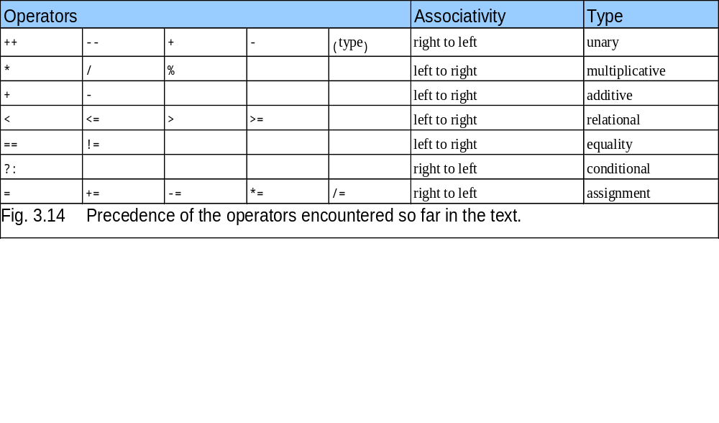
3.12 Increment and Decrement Operators

